Slide 1
Methods 2 Classroom 12

Slide 2
TODAY
Assumptions of linear regression
Model comparison with leave-one-out cross validation

Slide 3
Assumptions of the linear model

Slide 4
Assumptions of the linear model
ROS mentions 6 assumptions
Validity
Representativeness
Additivity & linearity
Independence of errors
Equal variance of errors
Normality of errors

Slide 5
validity
The data you are analysing should map the research question you are trying to answer
Include all relevant predictors
Example:
I want to investigate the rate of students cheating on a test
I ask the class if they cheat. Everyone says that they don’t cheat.
Can I conclude that no one cheats? No…

Slide 6
Representativeness
What you are investigating should generalize to the cases in which it will be applied
Always consider whether the population which you use to fit your model is representative of the populution for which you want to generalize your findings
Example:
Results from a diet and exercise study performed among patients at the risk of heart disease may not be generally applicable to healthy individuals.

Slide 7
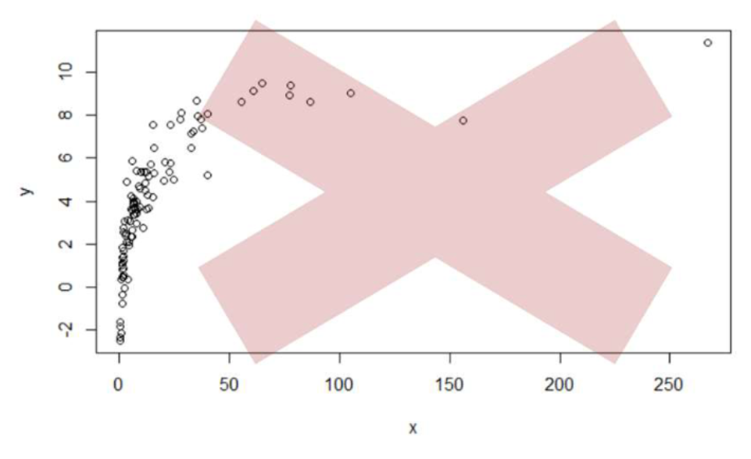
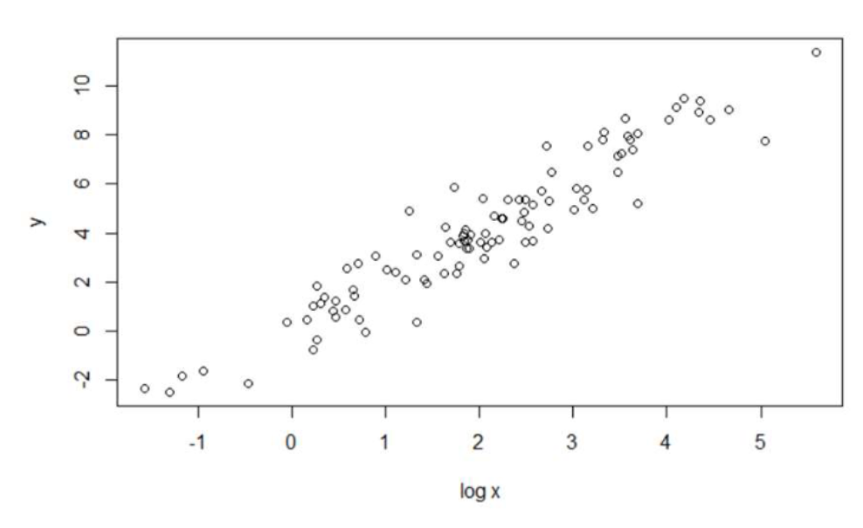
Additivity / Linearity
The dependent variable is a linear function of the predictors
a) The expected value of the dependent variable is a linear (straight-line) function of each independant variable (holding the other variables constant). (If not the case think about log-transformations)
b) The slope of the line should not depend on the values of the other variables. (If not the case, think of adding an interaction)
c) The effects of the different independent variables on the dependent variable are additive

Slide 8
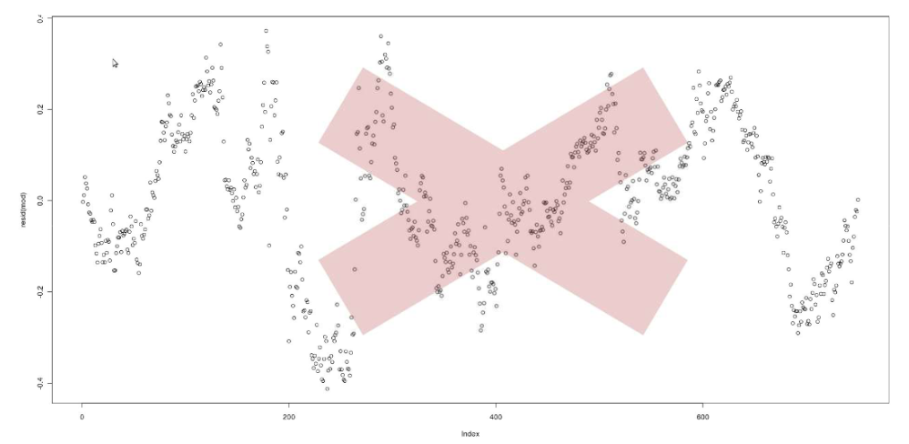
Independence of errors
Residuals should be randomly and symmetrically distributed around 0.
That is we don’t want autocorrelation.
Autocorrelation is a correlation coefficient. However, instead of being the correlation between two different variables it is the correlation between two values of the same variable at times t and t+1.

Slide 9
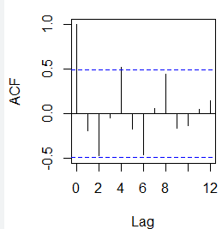
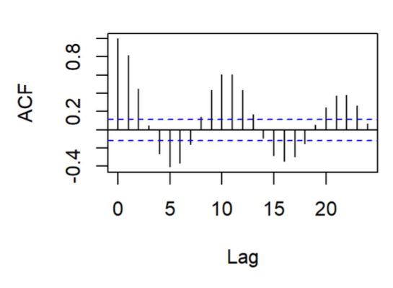
Independence of errors
Plotting the autocorrelation

Slide 10
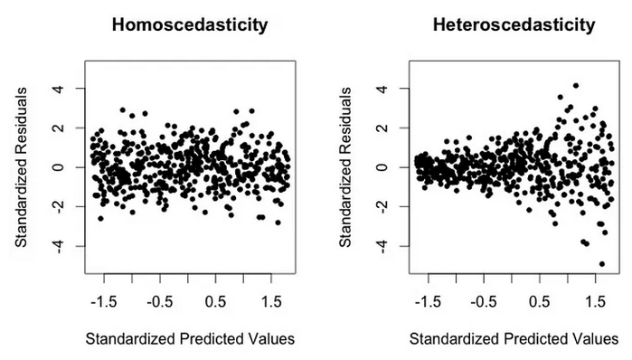
Equal Variance of errors
Also known as violoations of homoscedasticity (heteroscedasticity).
It means that the spread of the residuals should be equal for every predicted y
Investigate by plotting the standardized
residuals

Slide 11
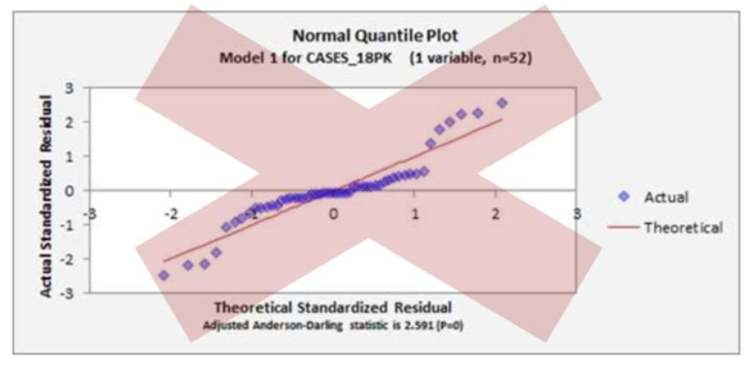
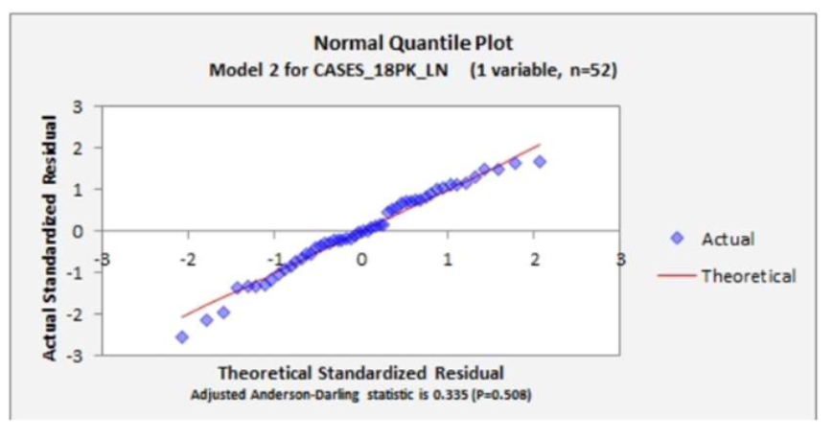
Normality of errors
The errors should be approximately normally distributed
Investigate by plotting qq-plots or inspect the residual density plot
qq-plots: plot of two sets of quantiles against each other. In the normal quantile plot we compare the normal theoretical quantiles to the actual ones of our data.
For more on qq-plots: https://towardsdatascience.com/q-q-plots-explained-5aa8495426c0

Slide 12
Model comparison & Evaluation

Slide 13
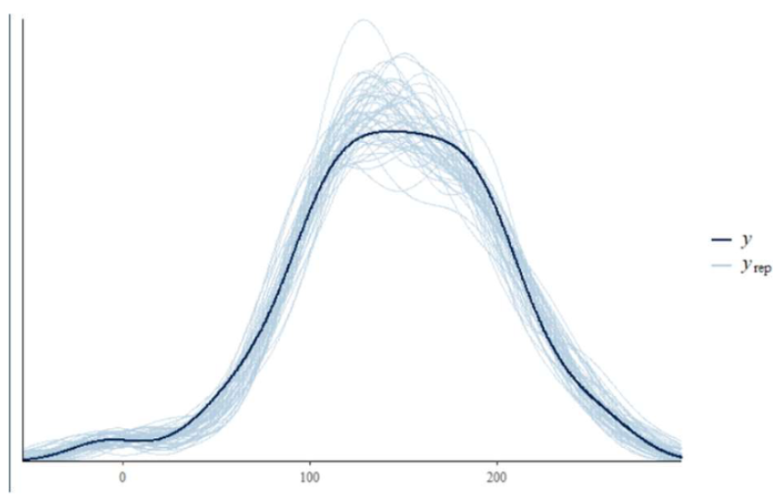
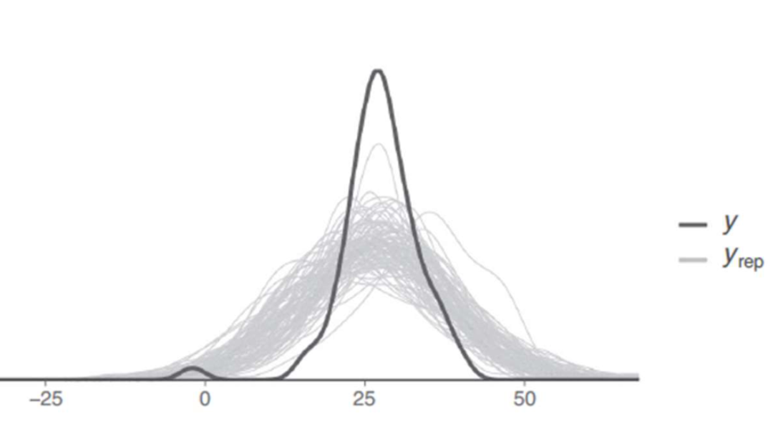
posterior predictive checks
Comparing the observed predicted y variable to simulated predicted variables y_rep using parameters from the posterior distribution

Slide 14
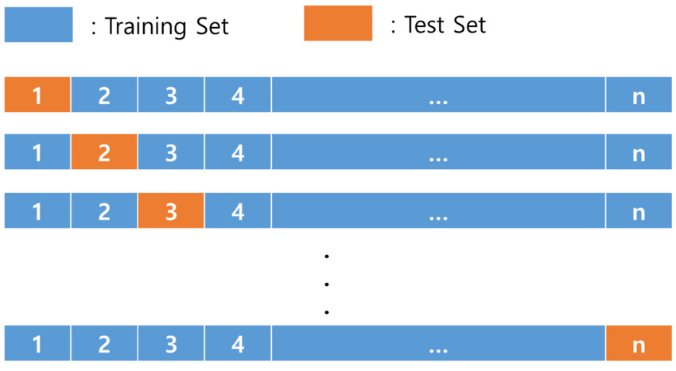
Leave one out cross-validation
Technique to avoid overfitting (but at the cost of increased computation)
All data exept one data point is used to fit the model (training set)
The remaining data point is used as the test set
Average prediction error over all n fits

Slide 15
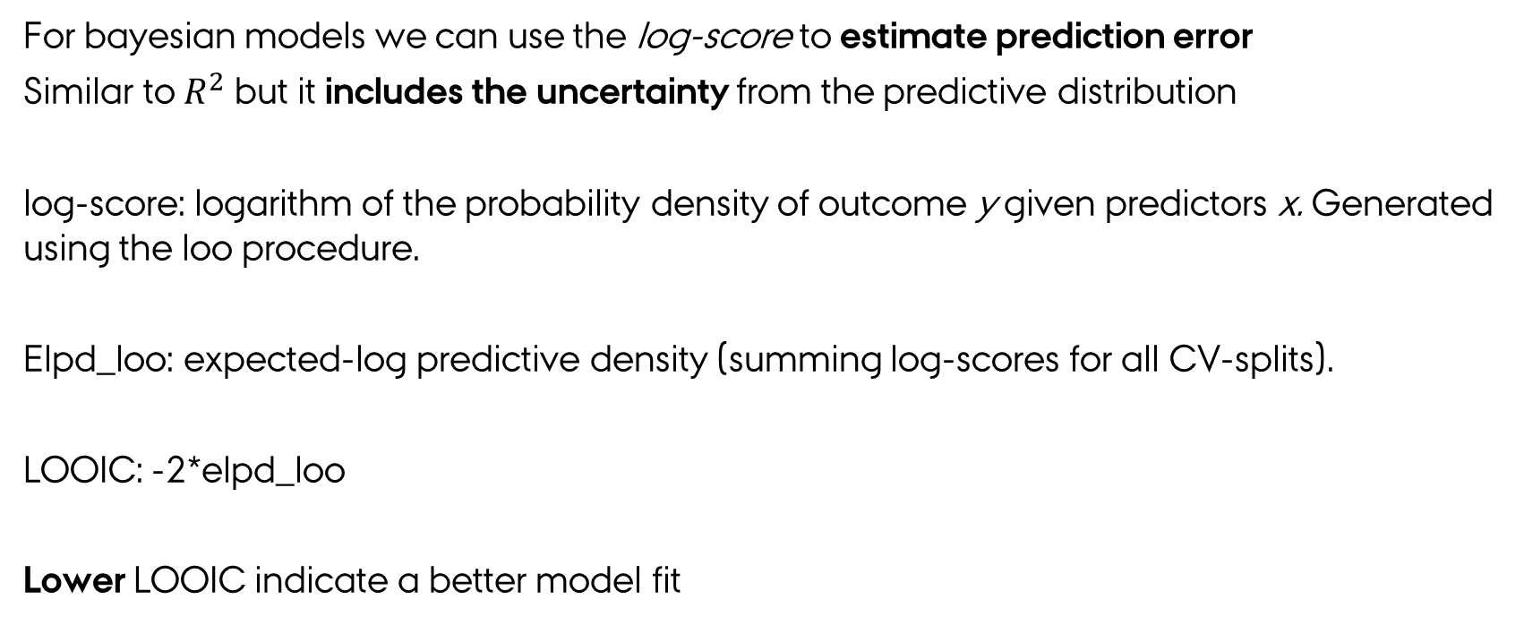
LOOIC
For bayesian models we can use the log-score to estimate prediction error
Similar to $R^{2}$ but it includes the uncertainty from the predictive distribution
log-score: logarithm of the probability density of outcome y given predictors x. Generated using the loo procedure.
Elpd_loo: expected-log predictive density (summing log-scores for all CV-splits).
LOOIC: -2*elpd_loo
Lower LOOIC indicate a better model fit

Slide 16
Exercises
Exercises from ROS
11.5
11.9
11.3
Link to the exercise notebook: https://classroom.github.com/a/TNZEoBUr

